Slide 1
Topic: Covid-19 Pandemic Forecasting and Analysis of its Impact on African Continent.
Team Members: 1. NIYITEGEKA Janvier
2. NKIRANUYE Sangwa Emmanuel
3. MUKAMANA Florentine
4. SINDIKUBWABO Emmanuel

Slide 2
Presentation Agenda
Introduction and Background
Problem statement
Objective of the study
Dataset used
Data Cleaning methodology
Data Analysis process
Data Visualization
Covid-19 Forecasting Process
Results
Conclusion and Recommendation
References

Slide 3
Background and Introduction
Covid-19 is fatal virus type and it is killing many people in different corners of the world! This virus is extremely contagious and spreads rapidly, posing a global health threat.
Various existing treatments are also utilized to treat the illness, but the precise and appropriate treatment is still being researched.
Different covid-19 vaccinations were adapted by different countries across the world and Africa particularly. But there is unbalance vaccinations accessibilities between African countries and remaining world.
Therefore, the impact of fully vaccinations in Africa needs to be assessed for helping the government in future planning.
The current work aims to analyze the impact of covid-19 vaccinations on Good health and well-being as one of Sustainable Development Goals and projection of Covid-19 growth in Africa.

Slide 4
Problem Statement
Covid-19 is a global pandemic that kills people in different corners of the world. Some countries adapted different measures to fight against this pandemic but others are still underestimating the effect of the disease.
Thus we find out that it is very important to analyse the effected of this pandemic on Africa continent and different factors that are contributing to this pandemic.
We find also that it is very important to forecast the covid-19 growth for help the government in their future planning.

Slide 5
Study main objectives
Analyze the impact of Covid-19 on African continent between 2020 and 2021
Building LSTM Model for forecasting Covid-19 in the future

Slide 6
Used Datasets
138046
The dataset used contains138046 samples of 67 different features.
Source: https://github.com/owid/covid-19-data/blob/master/public/data/README.md

Slide 7
Data Cleaning
Data cleaning was based on the following points:
Checking correlation between independent and dependent variables
Selecting the variables of interest based on correlation value
Deleting samples that contains many missing values
Replacing the missing values in feature columns using the previous recorded data.
Replacing the missing values in a given column using the data from the related columns.

Slide 8
Data Analysis Process
Import required python libraries
Visualizing dataset using python script
Data cleaning
Checking correlation between variables
Selecting the variables of interest based on correlation value
Comparing covid-19 cases and deaths across African continent

Slide 9
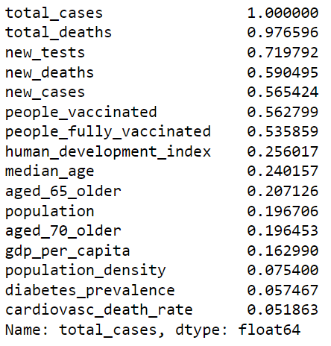
Data Visualization: Correlation Matrix 1
The right figure shows the correlation matrix that shows relationship between covid-19 and its parameters of interest.

Slide 10
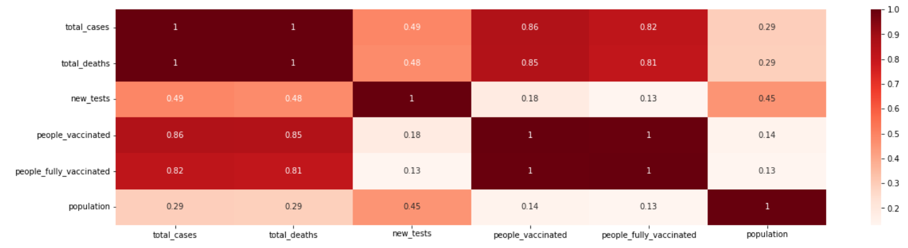
Data Visualization: Correlation Matrix 2
This shows that population, new_tests, people_fully_vaccinated and people_vaccinated are highly correlated with the total covid-19 cases. So, they can be used to forecast Covid-19 cases.

Slide 11
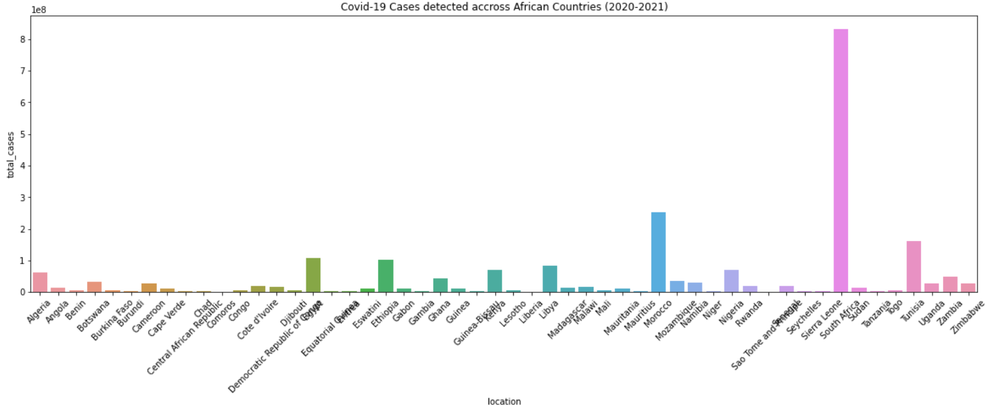
Data Visualization: Covid-19 detected cases across African Countries(2020-2021)
This shows that the countries Sierra Leone, Mauritius, Tunisia, Diibouti, Eswatini, Libya, Guinea Bisaw and Nigeria were highly affected by Covid-19 respectively based on the number of cases detected.

Slide 12
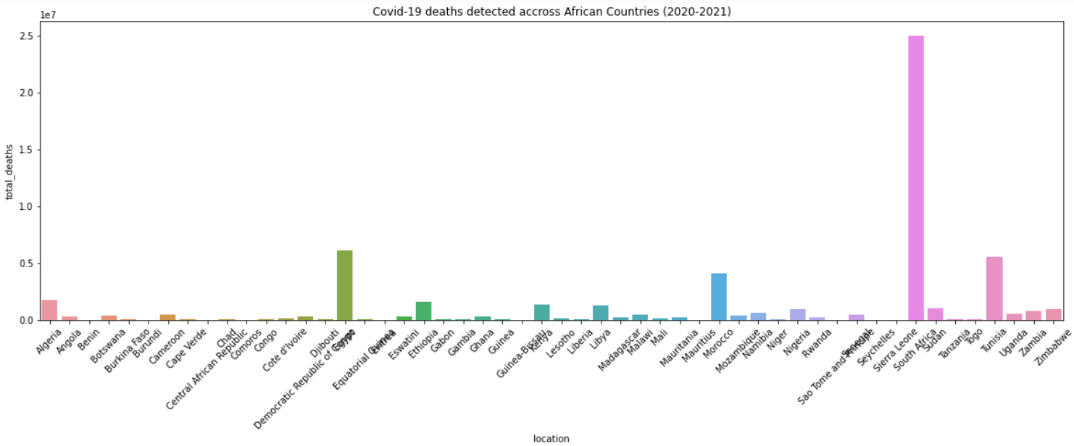
Data Visualization Covid-19 deaths detected across African Countries (2020-2021)
This shows that the countries Sierra Leone, Diibouti, Tunisia, and Mauritius were highly affected by Covid-19 respectively based on the number of deaths

Slide 13
Covid-19 Forecasting Process
Preparing dataset for LSTM Model
Building LSTM Model
Compiling LSTM model
Training LSTM model
Making prediction for 60 days ahead
Putting forecast data on graph
Comparing Machine Learning models to predict covid-19 cases
Plotting Features importance

Slide 14
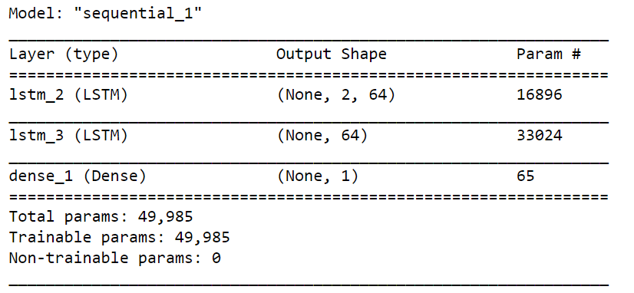
Covid-19 Forecasting/Model Summary
As shown in right figure, for building Recurrent Neural Network to forecast model we used two LSTM hidden layers of 64 neurons for each and one output dense layer of single neuron.

Slide 15
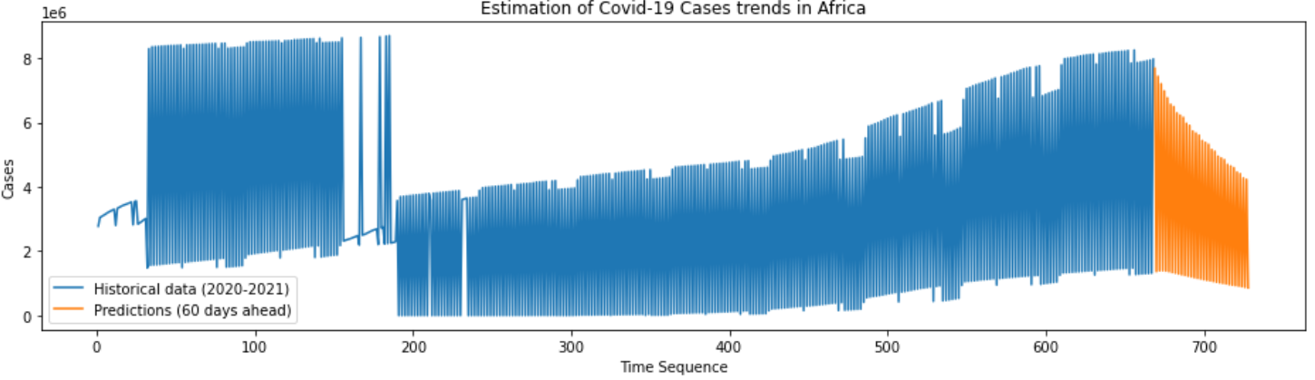
Results_1: Covid-19 Cases forecast in 60 days ahead
According to the figure above the Covid-19 cases are subjected to be decreased in Africa in 60 days ahead as the people continue taking Covid-19 vaccinations as informed by WHO.

Slide 16
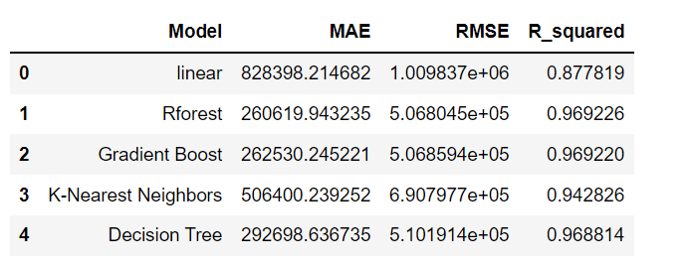
Results_2: Comparing Machine Learning models for Covid-19 cases prediction
During model evaluation on training data the right results were found

Slide 17
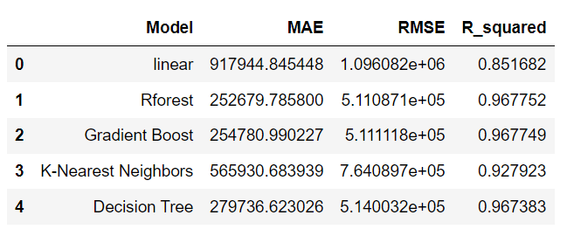
Results_3: Comparing Machine Learning models for Covid-19 cases prediction
During model evaluation on testing data the right results were found

Slide 18
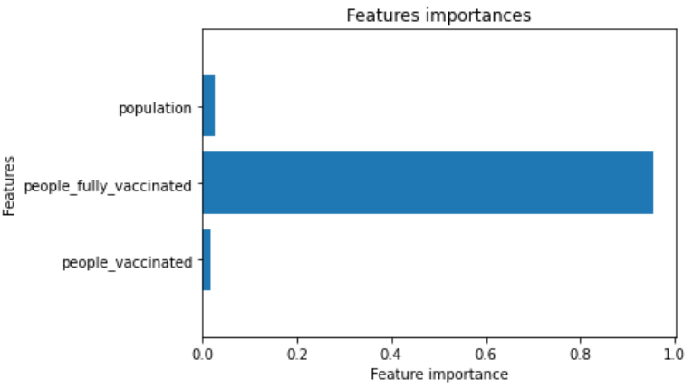
Results_4: Features importance during of model training
The right figure shows Predictors Contributions on Covid-19 cases Prediction

Slide 19
Conclusion and Recommendation
According to the results presented in this presentation, the objectives of the current study were achieved. The analysis of covid-19 pandemic on African continent was done and the results shows the correlation between different factors contributing to covid-19 growth. Finally, LSTM based model was used to forecast the future behavior of covid-19 growth.
The study shows that as the people continue to take covid-19 vaccinations, this may put an end to the covid-19 pandemic in Africa.
Therefore we recommend the government to encourage their citizens to take vaccinations as indicated by WHO.

Slide 20
Reference
https://unctad.org/osgstatement/impact-covid-19-african-continent
https://healthpolicy-watch.news/impact-covid-19-african-continent/
https://github.com/owid/covid-19-data/blob/master/public/data/README.md
https://machinelearningmastery.com/time-series-prediction-lstm-recurrent-neural-networks-python-keras/
https://machinelearningmastery.com/how-to-develop-lstm-models-for-time-series-forecasting/

